Slide 1
AS91906 (3.7) & AS91907(3.8) Documentation
Samuel Burgess
Notes:
3.7 AS91906 Programming & 3.8 AS91907

Slide 2
Crazy_Crashers_Final.py
Link to GitHub Repository: OneDrive
Links to Trello board / project management tools: Trello
Link to final version of your program: Crazy_Crashers_Final.py (alternatively you can download and extract the zip file named “Crazy_Crashers”)

Slide 3
Addressing Relevant Implications:
Relevant Implication – say what this means… | Why this is relevant to my outcome… | How did you address this implication
Functionality | Functionality is making sure the program works as expected. | I can address this outcome by testing that the program works not just for expected inputs, ; like “a” and “d”, but also unexpected ones such as “o”
Usability | Usability is about how easily usable the program is to the end use. | Creating clear control instructions, balancing, easy controls.
Aesthetics | Ensuring the project looks visually appealing | well spaced code, quality game assets.
Future proofing | Ensuring that the program is easily updated in the future | Easily modifiable, using comments to describe what is happening in the code
Notes:
List and explain the Relevant implications here.
Then as you develop your code, come back and discuss how the implications have been addressed. Insert additional slides as required.

Slide 4
Program Structure:
Notes:
Create a diagram showing your program’s structure and outline the classes and functions that you plan on developing. You are welcome to edit this slide once you start developing the outcome BUT when you do that, you should show what has changed and explain why those changes were needed.

Slide 5
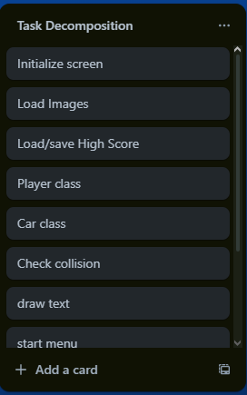
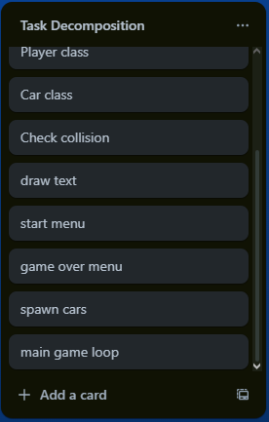
Problem Decomposition:
Notes:
Provide evidence showing that you have decomposed the task. This can be in the form of a trello screenshot or a list of components. If necessary, you may revisit this slide and add to it / edit it as you create your outcome. When you make changes to this slide, please do so in a different colour, date the changes and explain why they were made (this can help provide evidence for M / E grades).
Hint: Use the structure you developed earlier to work out what components you need. For each function, you should have at least one component.
Task Components
Put
Components
here

Slide 6
Component development:
Make as many copies of the next three slides as you need. For each component you should have…
A Trello screenshot / evidence of ongoing use of your project management tools
A test plan for the component that has been created BEFORE you start coding. Your plan should allow you to test all logical pathways for this component. It should also include test cases for relevant boundary and unexpected values.
Screenshot evidence showing that you have worked through the test plan you developed.
You should also provide evidence of trialling multiple components & techniques. Please make slides as needed for that evidence.
Notes:
Make as many copies of the next three slides as you need. For each component you should have…
A Trello screenshot / evidence of ongoing use of your project management tools
A test plan for the component that has been created BEFORE you start coding. Your plan should allow you to test all logical pathways for this component. It should also include test cases for relevant boundary and unexpected values.
Screenshot evidence showing that you have worked through the test plan you developed.
You should also provide evidence of trialling multiple components & techniques. Please make slides as needed for that evidence.

Slide 7
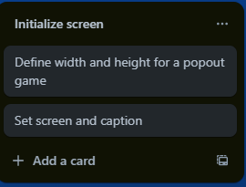
1 Component Planning: Initialize screen
In terms of screen size, I wanted to create a game that could be a popout window that you could play while doing other things, so I made the screen quite small.
Notes:
Duplicate this slide and use it to show your planning for the current component. This could be in the form of a Trello screenshot.

Slide 8
2 Component Test Plan: Initialize screen
Boundary cases aren’t really relevant to this component
Test Cases - input | Expected output
Start the game | Screen Appears
Notes:
Create a test plan for this component BEFORE you start coding. Your plan should allow you to test all logical pathways for this component. It should also include test cases for relevant boundary and unexpected values.

Slide 9
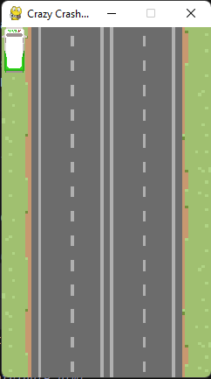
3 Evidence of testing: Initialize screen
Program works as expected – The screen of the defined size is drawn using pygame.
Notes:
Use this slide to provide evidence that you have tested your component in accordance with the test plan you developed earlier.

Slide 10
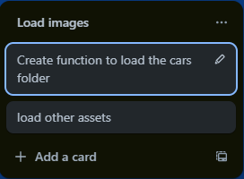
1 Component Planning: Load Images
As I have a number of game assets to load, I trialled loading an entire folder in a function to save time and code length.
Notes:
Duplicate this slide and use it to show your planning for the current component. This could be in the form of a Trello screenshot.

Slide 11
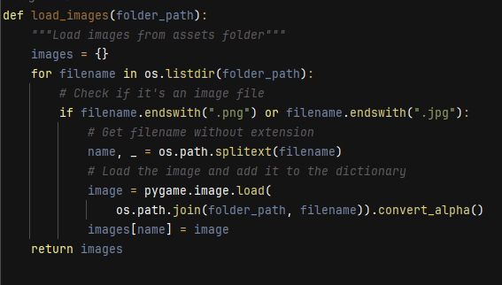
Trialling – Load Images (and user feedback)
Whaen I was showing him my program, my friend Josh said that he didn’t really like the look of the car sprite, so, to fit the relevant implication of aesthetics, I downloaded a free to use car sprite pack to use for car models. However, when I tried importing them, it looked clunky and was just a massive block of code. So, I trialled creating a Function to load the entire folder of images at once, and it worked. As this both saved on lines of code and made the code look nicer (for Aesthetics, I decided that the function was the way to go.

Slide 12
2 Component Test Plan: Load Images
Unfortunately, there is not much I can do to prevent a crash if the game assets are not downloaded. Because of this, I have created a zip file that includes both the game and game assets to make the game more accessible.
Test Cases - input | Expected output
Spawn a random car from the cars folder, and load the road image | The screen draws a car (random) on the road
Try to spawn in a car without the assets downloaded | The program crashes
Notes:
Create a test plan for this component BEFORE you start coding. Your plan should allow you to test all logical pathways for this component. It should also include test cases for relevant boundary and unexpected values.

Slide 13
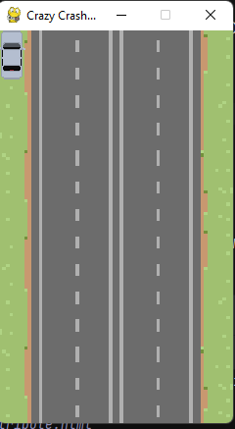
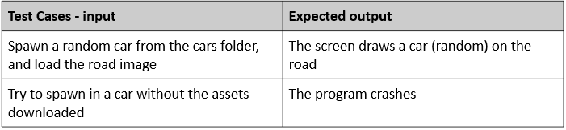
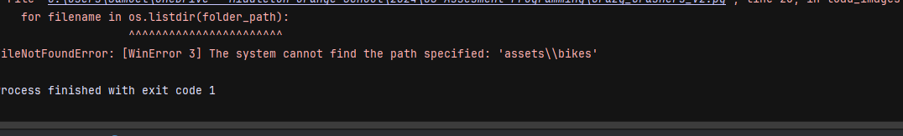
3 Evidence of testing: Load Images
Everything works as expected. The program crashes if assets are not downloaded, and loads all assets if they are.
Notes:
Use this slide to provide evidence that you have tested your component in accordance with the test plan you developed earlier.

Slide 14
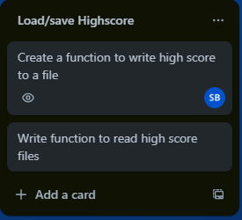
1 Component Planning: Load/save High Score
Notes:
Duplicate this slide and use it to show your planning for the current component. This could be in the form of a Trello screenshot.

Slide 15
2 Component Test Plan: Load/save High score
Test Cases - input | Expected output
No high score file | First games score is the new high score
Restart and don’t beat the high score | Highs core remains the same
Close and re-open game and don’t beat the high score | High score remains the same
Beat the high score | High score changes
Notes:
Create a test plan for this component BEFORE you start coding. Your plan should allow you to test all logical pathways for this component. It should also include test cases for relevant boundary and unexpected values.

Slide 16
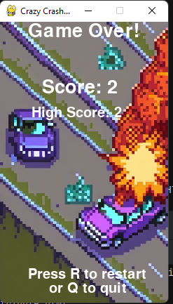
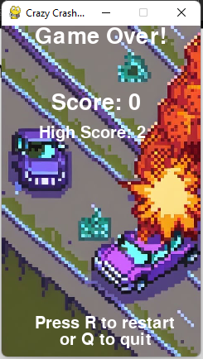
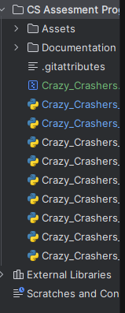

3 Evidence of testing: (1) Load/save High score
All works as expected
Notes:
Use this slide to provide evidence that you have tested your component in accordance with the test plan you developed earlier.

Slide 17

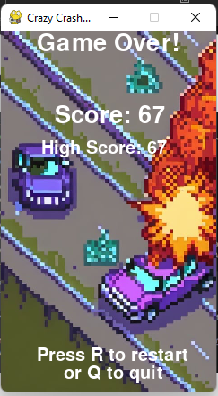
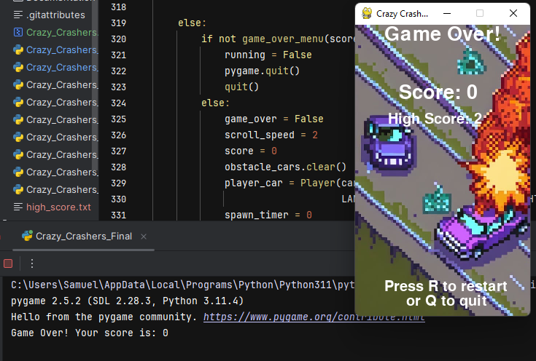
3 Evidence of testing: (2) Load/save High score
All works as expected
Notes:
Use this slide to provide evidence that you have tested your component in accordance with the test plan you developed earlier.

Slide 18
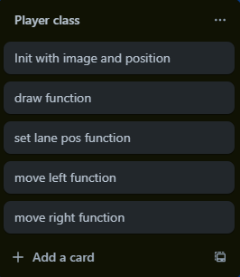
1 Component Planning: Player class
This class will handle the players car. It is initialized with image and position and has functions to draw itself on the screen and move left or right (using the set lane function to update position)
Notes:
Duplicate this slide and use it to show your planning for the current component. This could be in the form of a Trello screenshot.

Slide 19
2 Component Test Plan: Player Class
Test Cases - input | Expected output
Move left | Moves left
Move right | Moves right
Move right on the last lane | Nothing
Move left on the first lane | Nothing
Notes:
Create a test plan for this component BEFORE you start coding. Your plan should allow you to test all logical pathways for this component. It should also include test cases for relevant boundary and unexpected values.

Slide 20
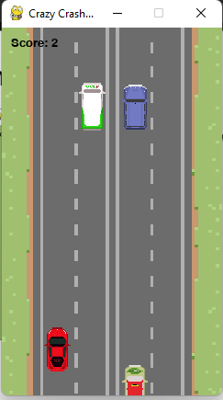
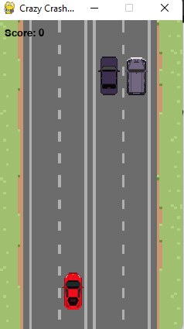
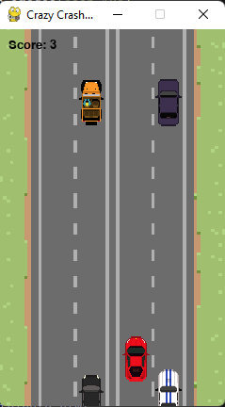
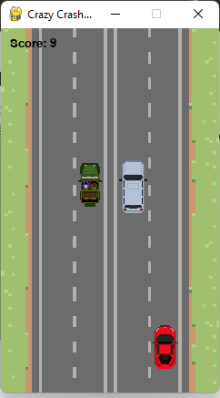
3 Evidence of testing: Player Class
This is hard to show in screenshots, but I have tested this thoroughly and I will show a picture of the car in each lane. Everything works as expected., and attempting to move outside of the four lanes does not work
Notes:
Use this slide to provide evidence that you have tested your component in accordance with the test plan you developed earlier.

Slide 21
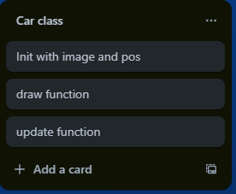
1 Component Planning: car class (obstacles)
How might your component work. This could be in the form of a Trello screenshot.
Notes:
Duplicate this slide and use it to show your planning for the current component. This could be in the form of a Trello screenshot.

Slide 22
2 Component Test Plan: Car class
Create a test plan for this component BEFORE you start coding. Your plan should allow you to test all logical pathways for this component. It should also include test cases for relevant boundary and unexpected values.
Test Cases - input | Expected output
Play the game | Cars in groups of 1 2 or 3 move down the screen at the rate of scrolling
Notes:
Create a test plan for this component BEFORE you start coding. Your plan should allow you to test all logical pathways for this component. It should also include test cases for relevant boundary and unexpected values.

Slide 23
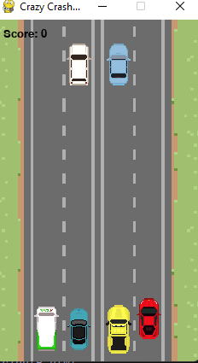

3 Evidence of testing: Car class
Use this slide to provide evidence that you have tested your component in accordance with the test plan you developed earlier.
Everything works as expected
Notes:
Use this slide to provide evidence that you have tested your component in accordance with the test plan you developed earlier.

Slide 24
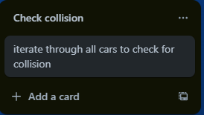
1 Component Planning: Check collision
How might your component work. This could be in the form of a Trello screenshot.
Notes:
Duplicate this slide and use it to show your planning for the current component. This could be in the form of a Trello screenshot.

Slide 25
2 Component Test Plan: Check collision
Create a test plan for this component BEFORE you start coding. Your plan should allow you to test all logical pathways for this component. It should also include test cases for relevant boundary and unexpected values.
Test Cases - input | Expected output
Collide with an obstacle | Game should end
Don’t collide | Game doesn’t end
Notes:
Create a test plan for this component BEFORE you start coding. Your plan should allow you to test all logical pathways for this component. It should also include test cases for relevant boundary and unexpected values.

Slide 26
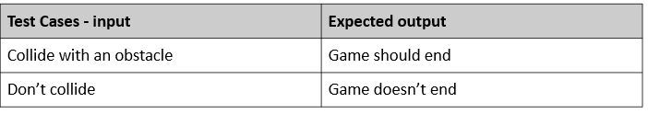
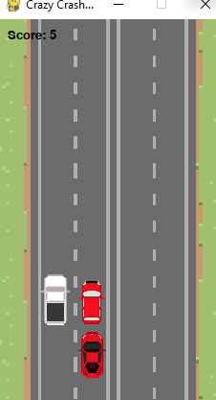
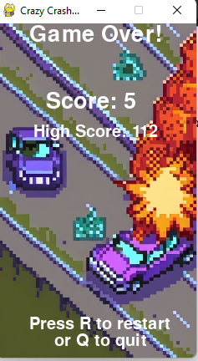
3 Evidence of testing: Check collision
Everything works as expected
Notes:
Use this slide to provide evidence that you have tested your component in accordance with the test plan you developed earlier.

Slide 27
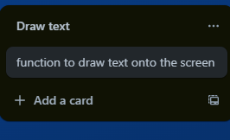
1 Component Planning: Draw Text
How might your component work. This could be in the form of a Trello screenshot.
Notes:
Duplicate this slide and use it to show your planning for the current component. This could be in the form of a Trello screenshot.

Slide 28
2 Component Test Plan: Draw text
No boundary/unexpected cases as this is not user controlled
Test Cases - input | Expected output
Write “crazy crashers” in black | Text appears on screen
Write “A or D” in white | Text appears on screen
Notes:
Create a test plan for this component BEFORE you start coding. Your plan should allow you to test all logical pathways for this component. It should also include test cases for relevant boundary and unexpected values.

Slide 29
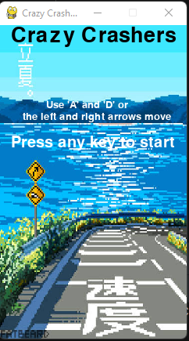
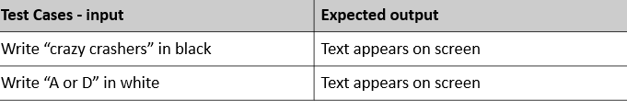
3 Evidence of testing: Draw Text
Everything works as expected
Notes:
Use this slide to provide evidence that you have tested your component in accordance with the test plan you developed earlier.

Slide 30
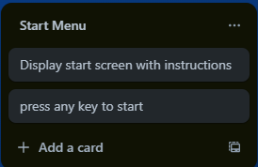
1 Component Planning: Start Menu
How might your component work. This could be in the form of a Trello screenshot.
Notes:
Duplicate this slide and use it to show your planning for the current component. This could be in the form of a Trello screenshot.

Slide 31
Trialling – start menu (and user feedback)
When I made the start menu, I originally used the art that I created for the end screen. However, my friend James told me that it just didn’t fit the start of the game, so I found an asset online (in creative commons) and used that, and James said it looked better. So after trialling both start screens I decided to go with the new art I found online.

Slide 32
2 Component Test Plan: Start Menu
Create a test plan for this component BEFORE you start coding. Your plan should allow you to test all logical pathways for this component. It should also include test cases for relevant boundary and unexpected values.
Test Cases - input | Expected output
Start the program | Start screen appears
Press a key | Game starts
Exit | Program quits
Notes:
Create a test plan for this component BEFORE you start coding. Your plan should allow you to test all logical pathways for this component. It should also include test cases for relevant boundary and unexpected values.

Slide 33
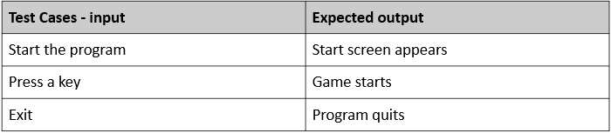
3 Evidence of testing: Start menu
All works as expected
Notes:
Use this slide to provide evidence that you have tested your component in accordance with the test plan you developed earlier.

Slide 34
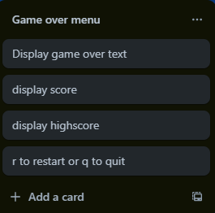
1 Component Planning: Game over menu
How might your component work. This could be in the form of a Trello screenshot.
Notes:
Duplicate this slide and use it to show your planning for the current component. This could be in the form of a Trello screenshot.

Slide 35
Trialling and user feedback – Game over menu
After finishing my game over menu, I showed it to my friend Cole, who immediately said that he couldn’t see anything, as the text was nearly the same colour as the background. Because of this, I created a new background and text colour for the game over screen, and when I showed it to him the next day, he said that it was a lot better.

Slide 36
2 Component Test Plan: Game over Menu
Create a test plan for this component BEFORE you start coding. Your plan should allow you to test all logical pathways for this component. It should also include test cases for relevant boundary and unexpected values.
Test Cases - input | Expected output
Press r | Game restarts
Press Q or the x on the window | Program quits
Anything else | nothing
Notes:
Create a test plan for this component BEFORE you start coding. Your plan should allow you to test all logical pathways for this component. It should also include test cases for relevant boundary and unexpected values.

Slide 37
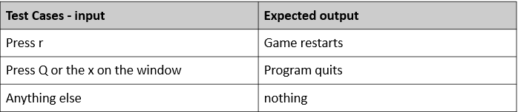
3 Evidence of testing: Game over Menu
Use this slide to provide evidence that you have tested your component in accordance with the test plan you developed earlier.
(Nothing happens)
Notes:
Use this slide to provide evidence that you have tested your component in accordance with the test plan you developed earlier.

Slide 38
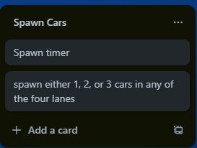
1 Component Planning: Spawn Cars
How might your component work. This could be in the form of a Trello screenshot.
Notes:
Duplicate this slide and use it to show your planning for the current component. This could be in the form of a Trello screenshot.

Slide 39
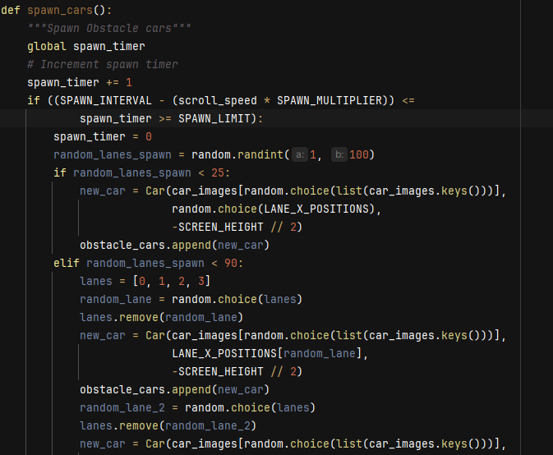
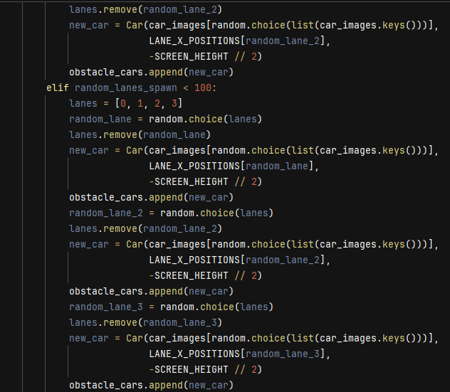
Trialling and user feedback – spawn cars
When I first introduced the car spawning, every spawn attempt a car would pick a lane and then spawn. This was working perfectly, but when my friend Ethan played the game he remarked that it felt like the cars came out of nowhere. So, I decided to re-write the car spawning algorithm so that each spawn attempt it spawns between 1 and three cars in randomized lanes, and when I let him play it again he said that the gameplay was a lot better, so following his advice I went with the second trial of spawning cars.

Slide 40
2 Component Test Plan: Spawn Cars
Create a test plan for this component BEFORE you start coding. Your plan should allow you to test all logical pathways for this component. It should also include test cases for relevant boundary and unexpected values.
Test Cases - input | Expected output
Play the game | Cars in groups of 1 2 or 3 move down the screen at the rate of scrolling
Notes:
Create a test plan for this component BEFORE you start coding. Your plan should allow you to test all logical pathways for this component. It should also include test cases for relevant boundary and unexpected values.

Slide 41
3 Evidence of testing: spawn Cars
Use this slide to provide evidence that you have tested your component in accordance with the test plan you developed earlier.
Everything works as expected
Notes:
Use this slide to provide evidence that you have tested your component in accordance with the test plan you developed earlier.

Slide 42
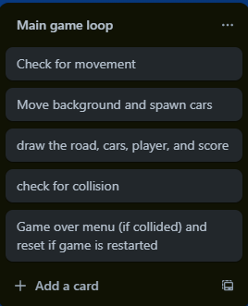
1 Component Planning: Main game loop
Notes:
Duplicate this slide and use it to show your planning for the current component. This could be in the form of a Trello screenshot.

Slide 43
2 Component Test Plan: Main game loop
Create a test plan for this component BEFORE you start coding. Your plan should allow you to test all logical pathways for this component. It should also include test cases for relevant boundary and unexpected values.
Test Cases - input | Expected output
Play the game | Game runs as intended, and then upon crash ends
Restart the game | Game runs again, and upon crash ends
Notes:
Create a test plan for this component BEFORE you start coding. Your plan should allow you to test all logical pathways for this component. It should also include test cases for relevant boundary and unexpected values.

Slide 44
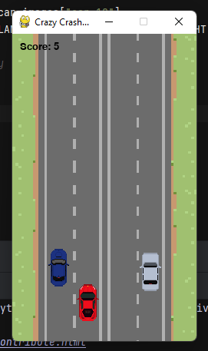
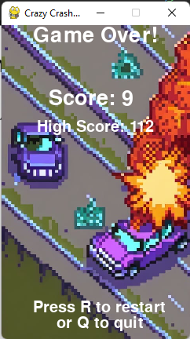
3 Evidence of testing: (1) Main game loop
Everything works as intended
Notes:
Use this slide to provide evidence that you have tested your component in accordance with the test plan you developed earlier.

Slide 45
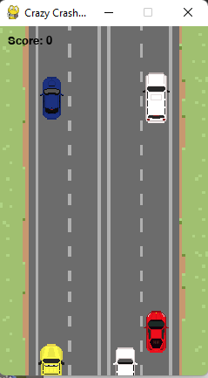
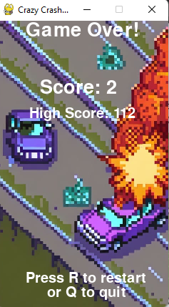
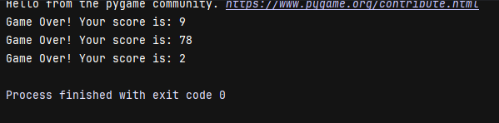
3 Evidence of testing: (2) Main game loop
Everything works as intended
Notes:
Use this slide to provide evidence that you have tested your component in accordance with the test plan you developed earlier.

Slide 46
Assembled Outcome Testing:
Assemble your components into a working program. On the slides that follow, please provide a test plan and evidence that your program works as expected.
If you are going for M / E, you also need to create extra slides showing how you have used your testing to improve the functionality of your program. This could mean having multiple test plans (and screenshots) showing several iterations of the assembled program.
Notes:
Assemble your components into a working program. On the slides that follow, please provide a test plan and evidence that your program works as expected.
If you are going for M / E, you also need to create extra slides showing how you have used your testing to improve the functionality of your program. This could mean having multiple test plans (and screenshots) showing several iterations of the assembled program.

Slide 47
1 Assembled Outcome Testing – Test Plan
Use this slide to provide a test plan for your complete program. You may wish to create multiple slides so that you can test for expected, boundary and unexpected cases.
Remember to test ALL logical pathways so that you can ensure your program works correctly.
Notes:
Use this slide to provide a test plan for your complete program. You may wish to create multiple slides so that you can test for expected, boundary and unexpected cases.
Remember to test ALL logical pathways so that you can ensure your program works correctly.

Slide 48
2 Assembled Outcome Testing - Evidence
Create as many slides as needed to provide evidence of testing that your outcome works for expected, boundary and unexpected cases.
Notes:
Create as many slides as needed to provide evidence of testing that your outcome works for expected, boundary and unexpected cases.

Slide 49
Address relevant Implications:
Relevant implication | Explain how your final outcome addresses each implication
Functionality | I have addressed functionality by comprehensively testing my program throughout the development process including relevant boundary inputs and unexpected inputs
Usability | I have addressed usability by making sure my program has clear instructions and is easy to use. I had peers use the program and give me feedback on this, and I have improved my program throughout using their advice
Aesthetics | I have made sure that the program looks good, including accepting user feedback to guide this.
Future proofing | I have added comments throughout my code so that any programmer could easily understand what is happening at any point and I have added doc strings at the top of each version

Slide 50
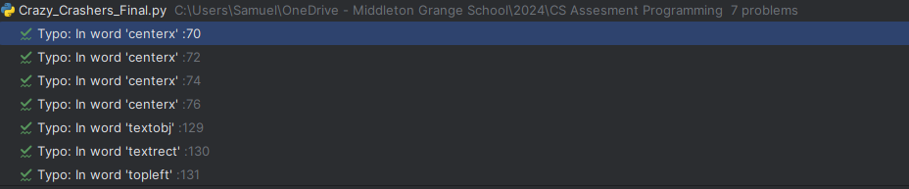
PEP8 Checking
The only PEP8 errors in my code are “typos” from my variable names that are shortened for aesthetics

Slide 51
Version control evidence

Slide 52
Complex processes - Discussion
While developing this program, planned, tested, and trailed its components and then later as a whole working car racing game, as shown in my evidence I tested every component, checking the program worked correctly on the boundary and unexpected inputs (where applicable), and I trialed Load images, spawn cars, start menu and game over menu by making two solutions for the same problem then choosing the better one.
By decomposing the problem, I was able to plan my program efficiently and was able to focus on creating and testing small chunks of code. Each of these chunks was thoroughly tested during and after construction, as you can see from my Trello board and the Trello decomposition slide for each component. I then used this to manage my time and take on small chinks of code one at a time, allowing me to create a comprehensive program in the selected timeframe.
By testing, was able to find and fix the flaws in my program before combining them into the full program, as you can see in each component, such as when I added none checkers to take care of accidental entry of nothing and checked if there were cards when deleting cards to avoid unwanted errors that crash the program.
Having volunteers test my program enabled me to further improve its functionality and get ideas about how to make it better which raised the reliability and quality of the finished program, such as when I had some of my peers use the Program and give me feedback, which included the game over menu being disorienting and the gameplay not being engaging enough, which led me to change the spawn cars function and the game over and start menu’s.
User feedback enabled me to look at the program from a non-programmer's point of view. This, combined with the information I got from the earlier Planning, testing, and trailing, enabled me to produce a high-quality program. This program is resilient to errors and crashing on unexpected inputs.
Notes:
Discuss how you used (and combined) information gained from the planning, testing and trialling of your components to improve the quality of your program. Note that synthesising information from planning, testing and trialling of components and then discussing how this led to a high quality outcome is needed for an E grade.

